Slide 1
Project LoFi
Juan Carlo Rebanal and Jeannie Hur

Slide 2
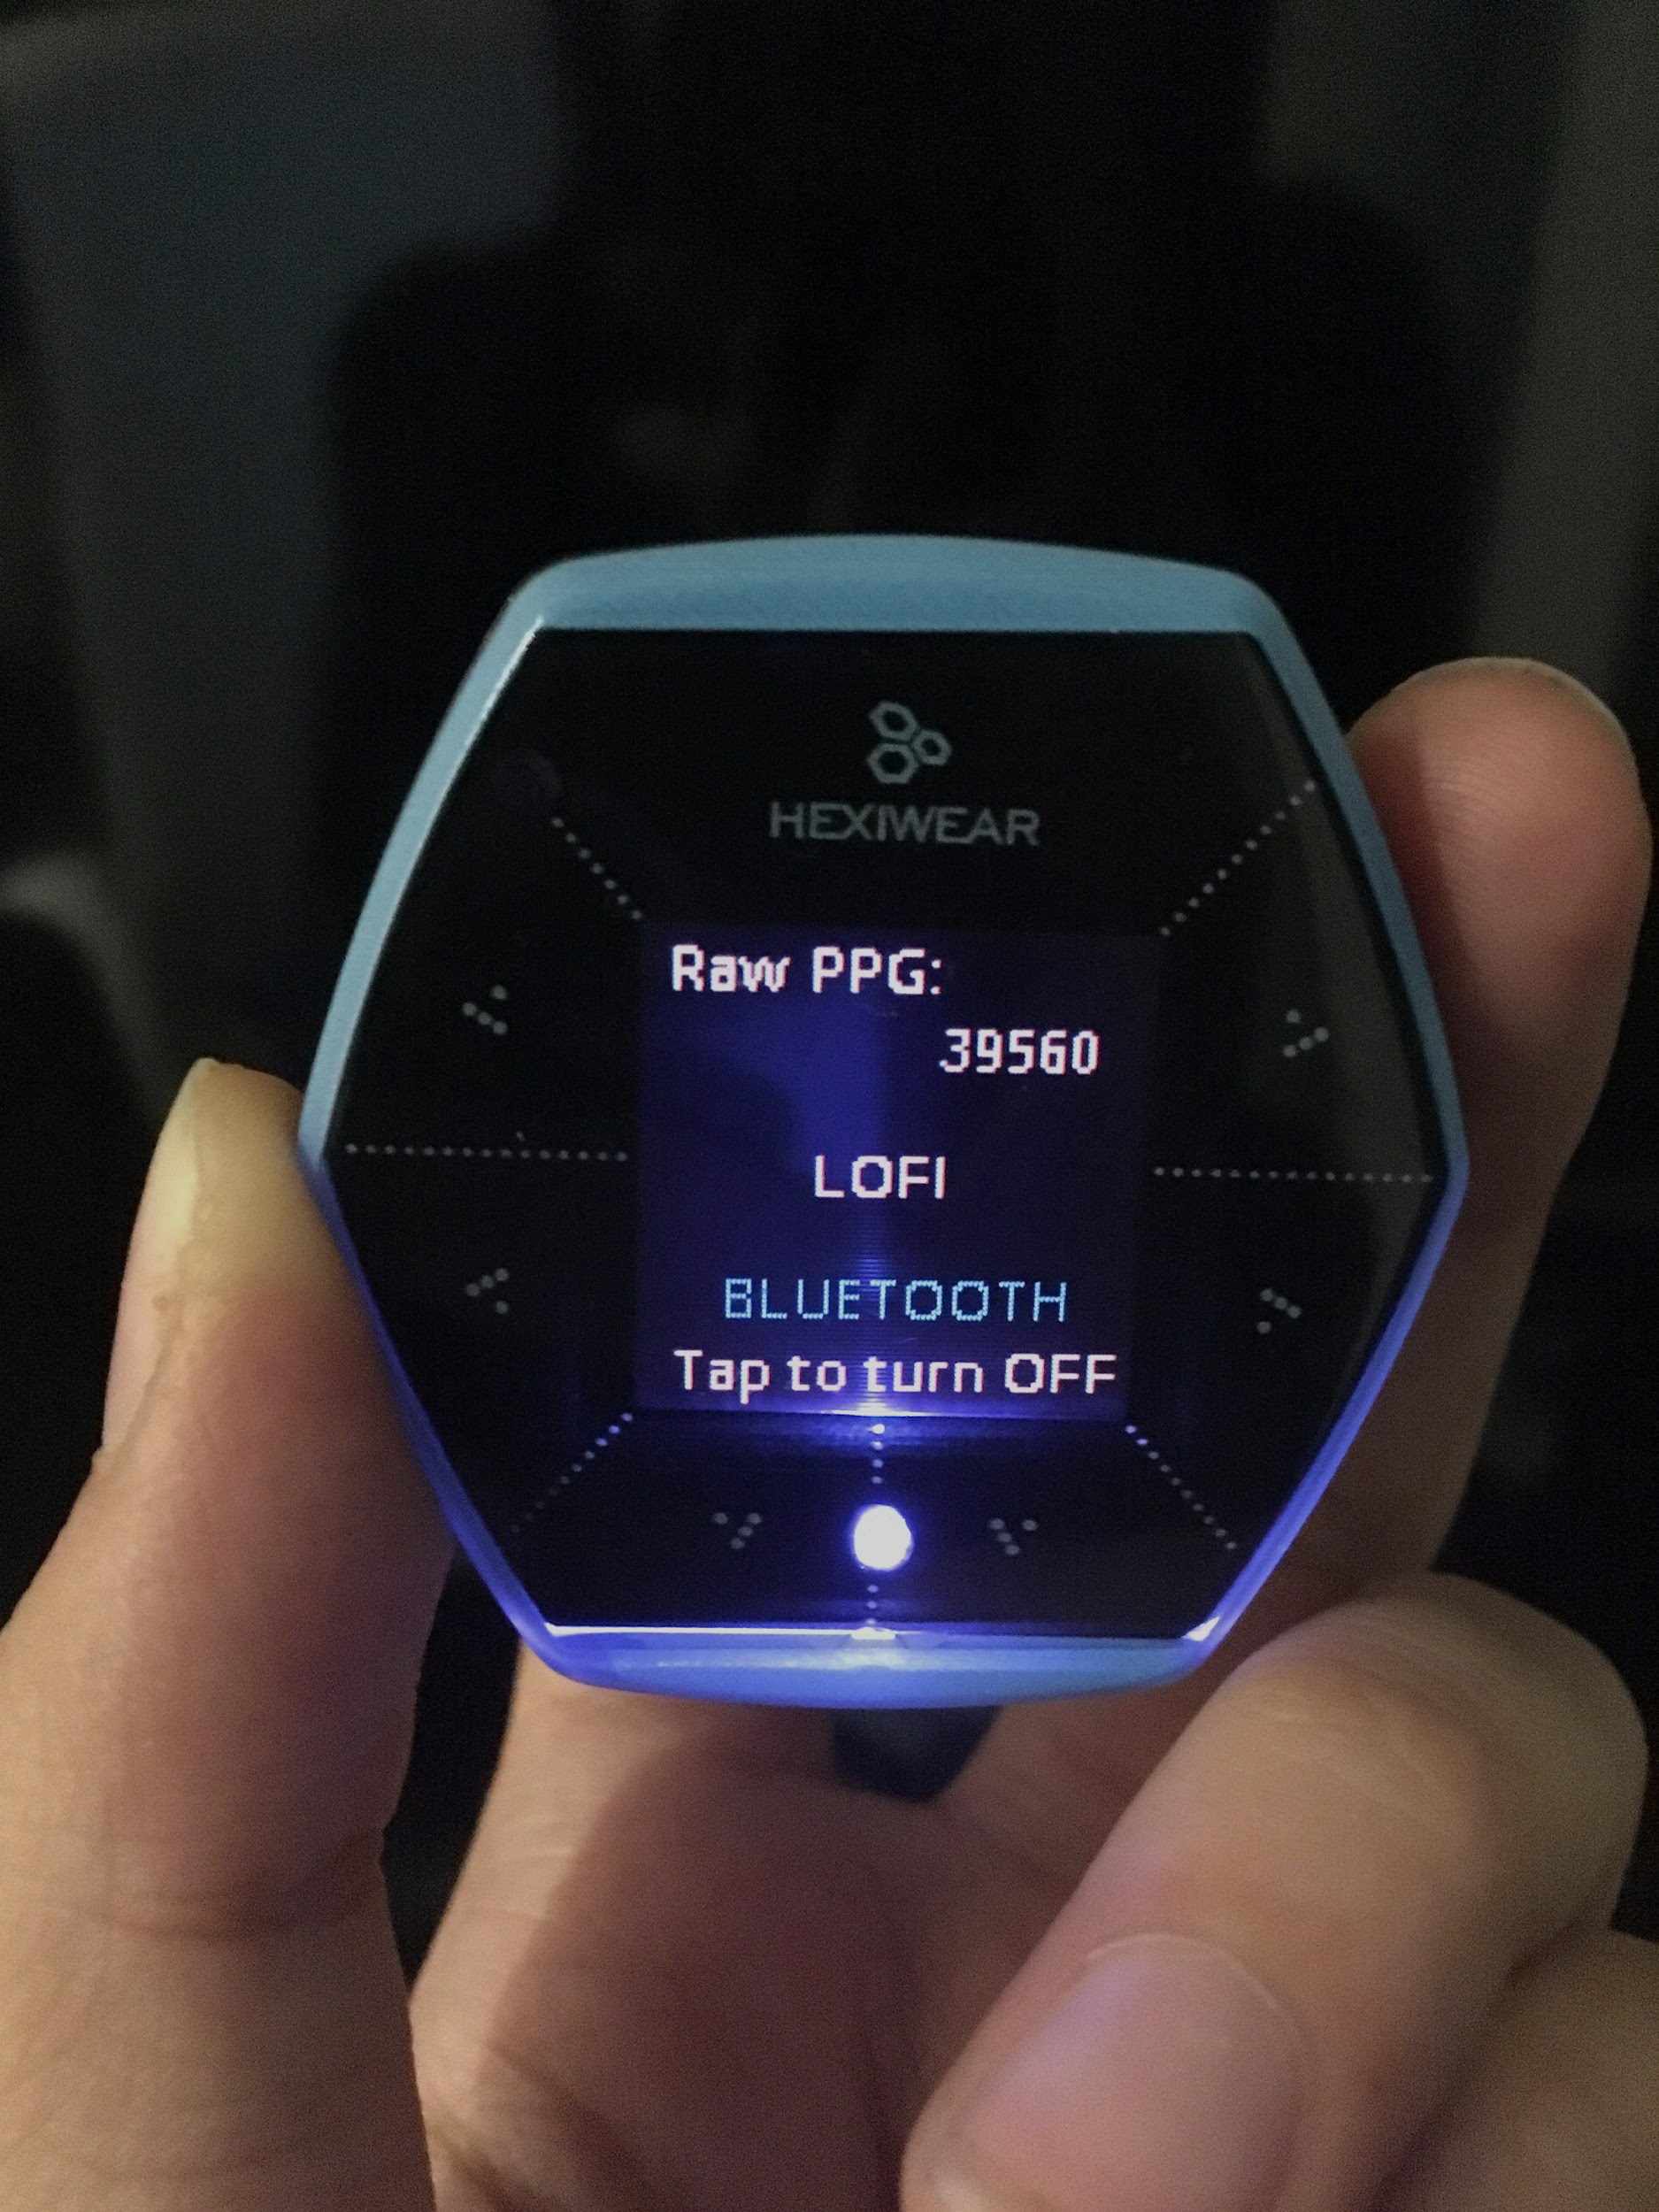
Purpose of Project LoFi
What is LoFi - Logical Fitness?
System that uses a user’s mood and activity to recommend music to improve exercise experience and everyday mood
Improve Experience when Jogging
Play music with tempo that matches cadence enhances “distraction effect”, which increases adherence/motivation to exercise^{[1]}
Match Mood through Daily Life
Play music that matches mood
Uses heart rate variability to estimate mood throughout the day and recommend music accordingly to improve mood and reduce stress
[1] Synchronized personalized music audio-playlists to improve adherence to physical activity among patients participating in a structured exercise program: a proof-of-principle feasibility study. Sports Med Open. 2015

Slide 3
System Architecture

Slide 4
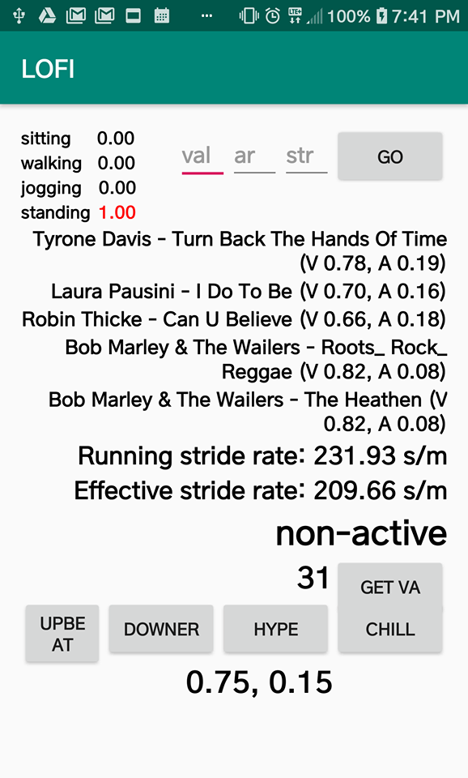
System Overview
Music Recommendation
If active, Android app recommends music based primarily on cadence but also mood
If not active, Android app recommends music based on mood and user preference
Activity Recognition
Android app measures accelerometer data on the phone,, then determines activity type and cadence
Mood Detection
Hexiwear measures PPG (photoplethysmography)
Hexiwear computes SDNN and HF/LF, measurements of HRV

Slide 5
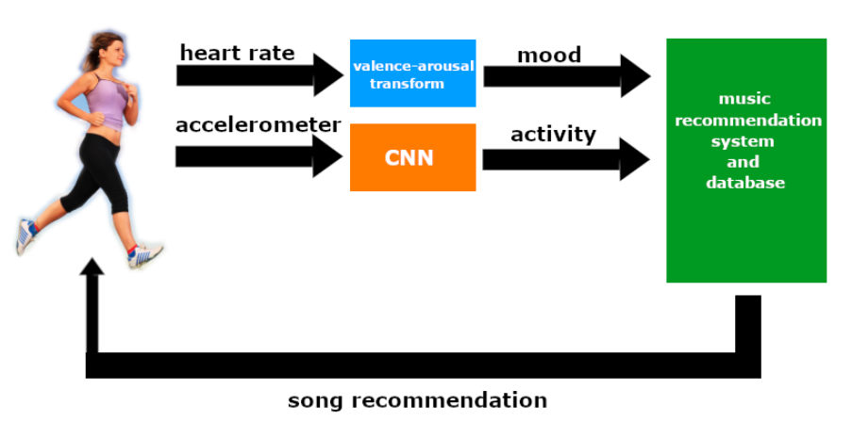

Slide 6
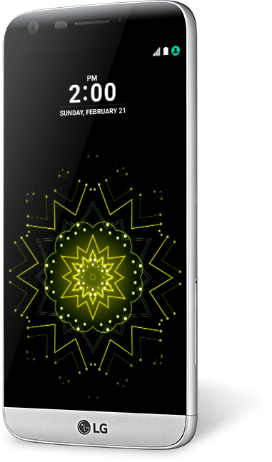
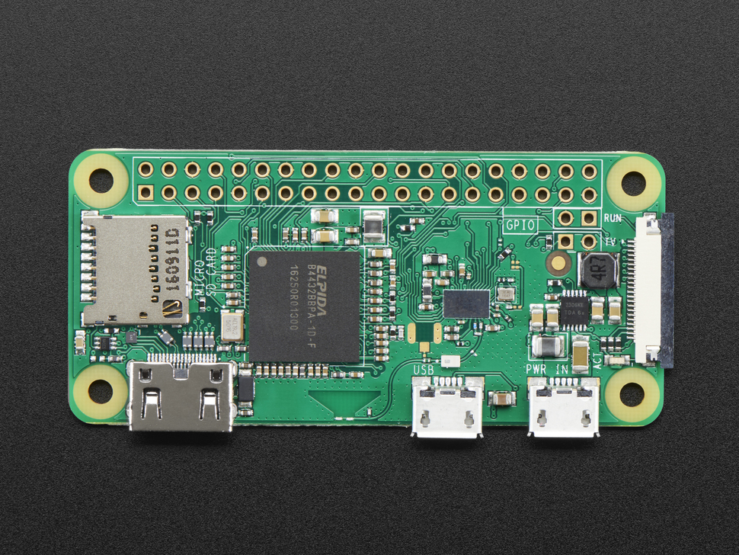
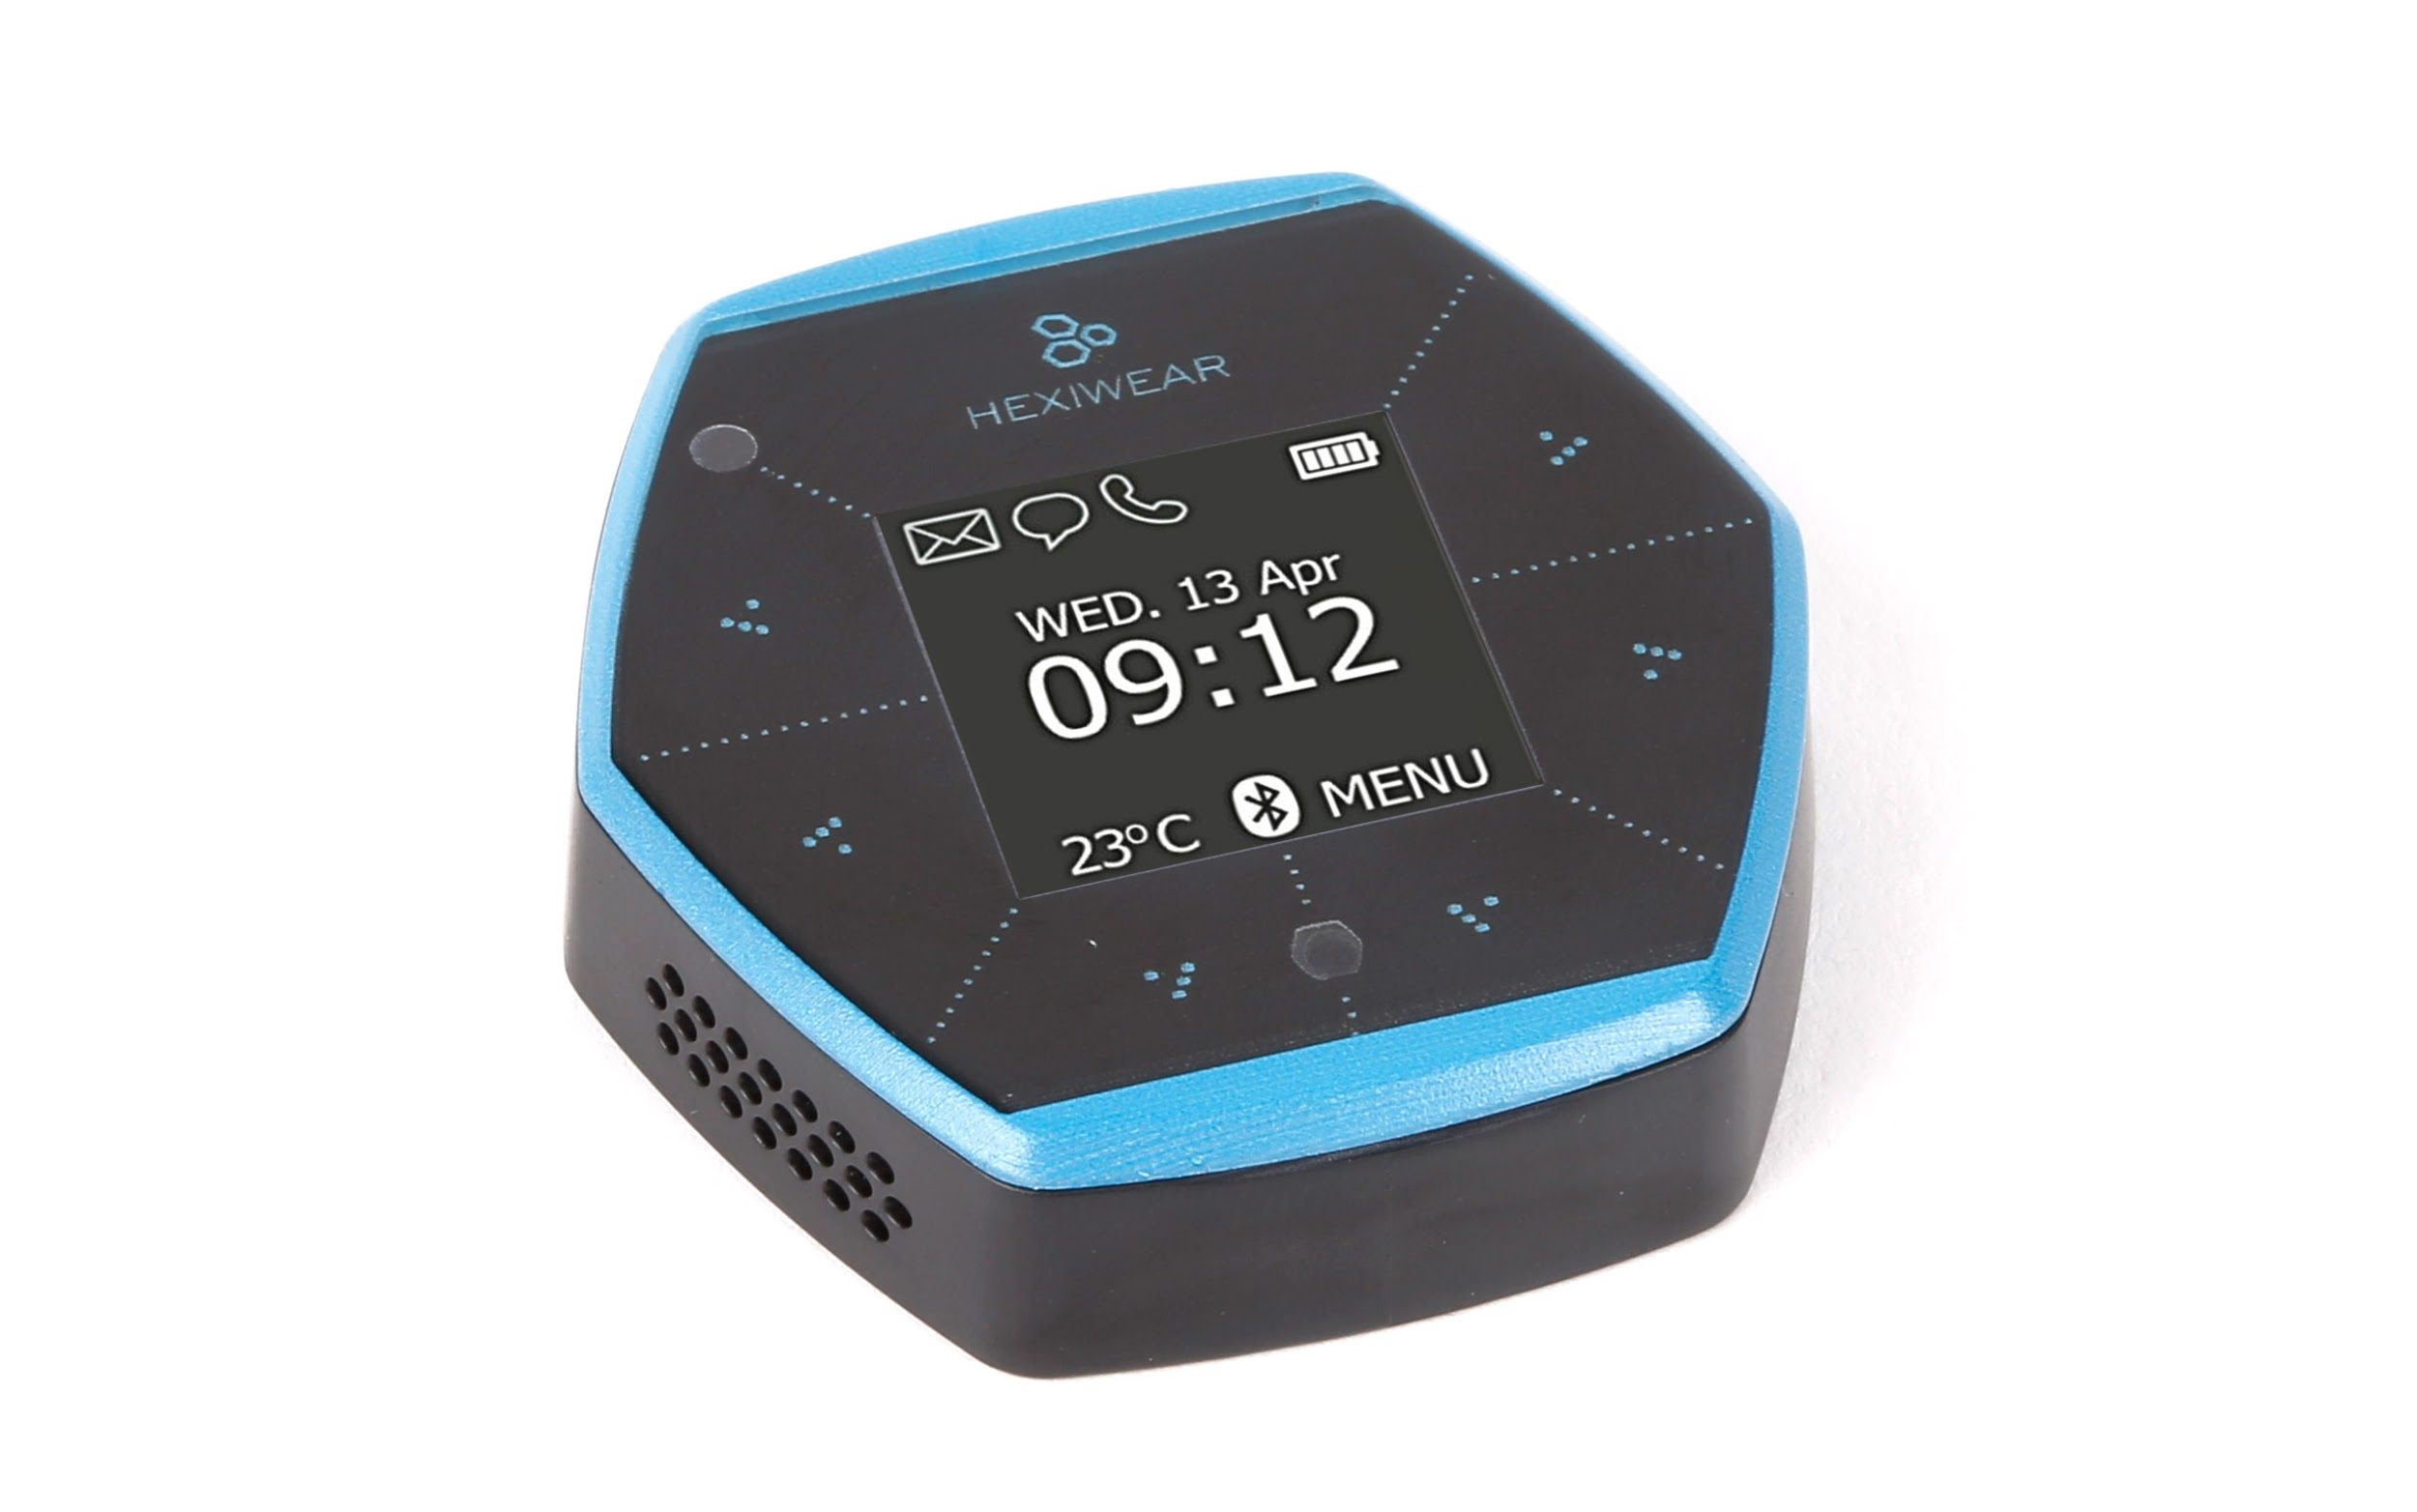
Hardware Components
Hexiwear (to measure PPG)
Raspberry Pi Zero W (to receive VA from Hexiwear)
Android smartphone (to run app, do activity recognition and pull VA from Pi-hosted site)

Slide 7
Key Software Components
MBed compiler (to write Hexiwear programs)
Bluepy and bluez (to handle BLE on Pi)
Cherrypy (to host a site using the Pi)
Raspbian Lite (raspberry Pi OS)
Android Studio (to develop app)
Keras and TensorFlow (to train and deploy neural network)
Pandas (to survey and construct dataset)
Matlab (to develop the PPG signal processing algorithm)
Git (version control)

Slide 8
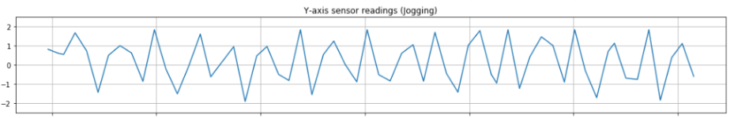
Cadence Measurements and Activity Recognition
Use Android step detector to average time between steps and get stride rate
Train CNN using activity prediction dataset to distinguish between activity levels: non-active and active
Used 3-second windows to train and test network
3-axis accelerometer data of smartphone in front leg pocket

Slide 9
Measuring HRV - SDNN and HF/LF
Define Terminology
SDNN - Standard Deviation of Normal to Normal R-R intervals
HF - absolute power in High Frequency (0.15 - 0.4 Hz)
LF - absolute power in Low Frequency (0.04 - 0.15 Hz)
PPG signal measured by Hexiwear over 5 seconds
Signal Processing of PPG signal to calculate SDNN
Subtracted moving average of PPG signal from PPG signal to normalize signal
Smoothed PPG signal by making it equal to its moving average of a smaller window size
Used AMPD Algorithm to find when the peaks occur and thus the time intervals between the peaks
Fast Fourier Transform (FFT) of PPG signal to calculate HF and LF
Found FFT of normalized and smoothed PPG signal
Found HF and LF by integrating the signal over their respective frequency ranges

Slide 10
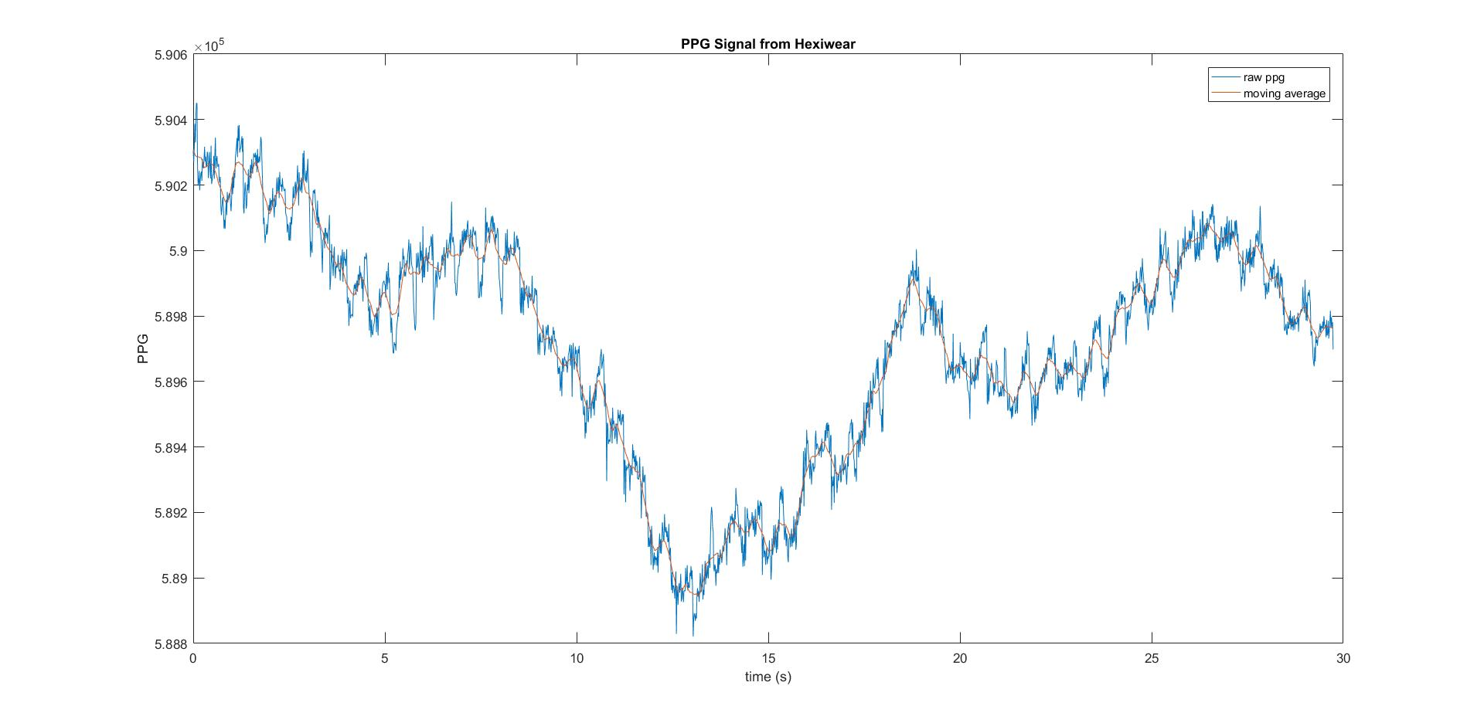
Plots generated by Matlab

Slide 11
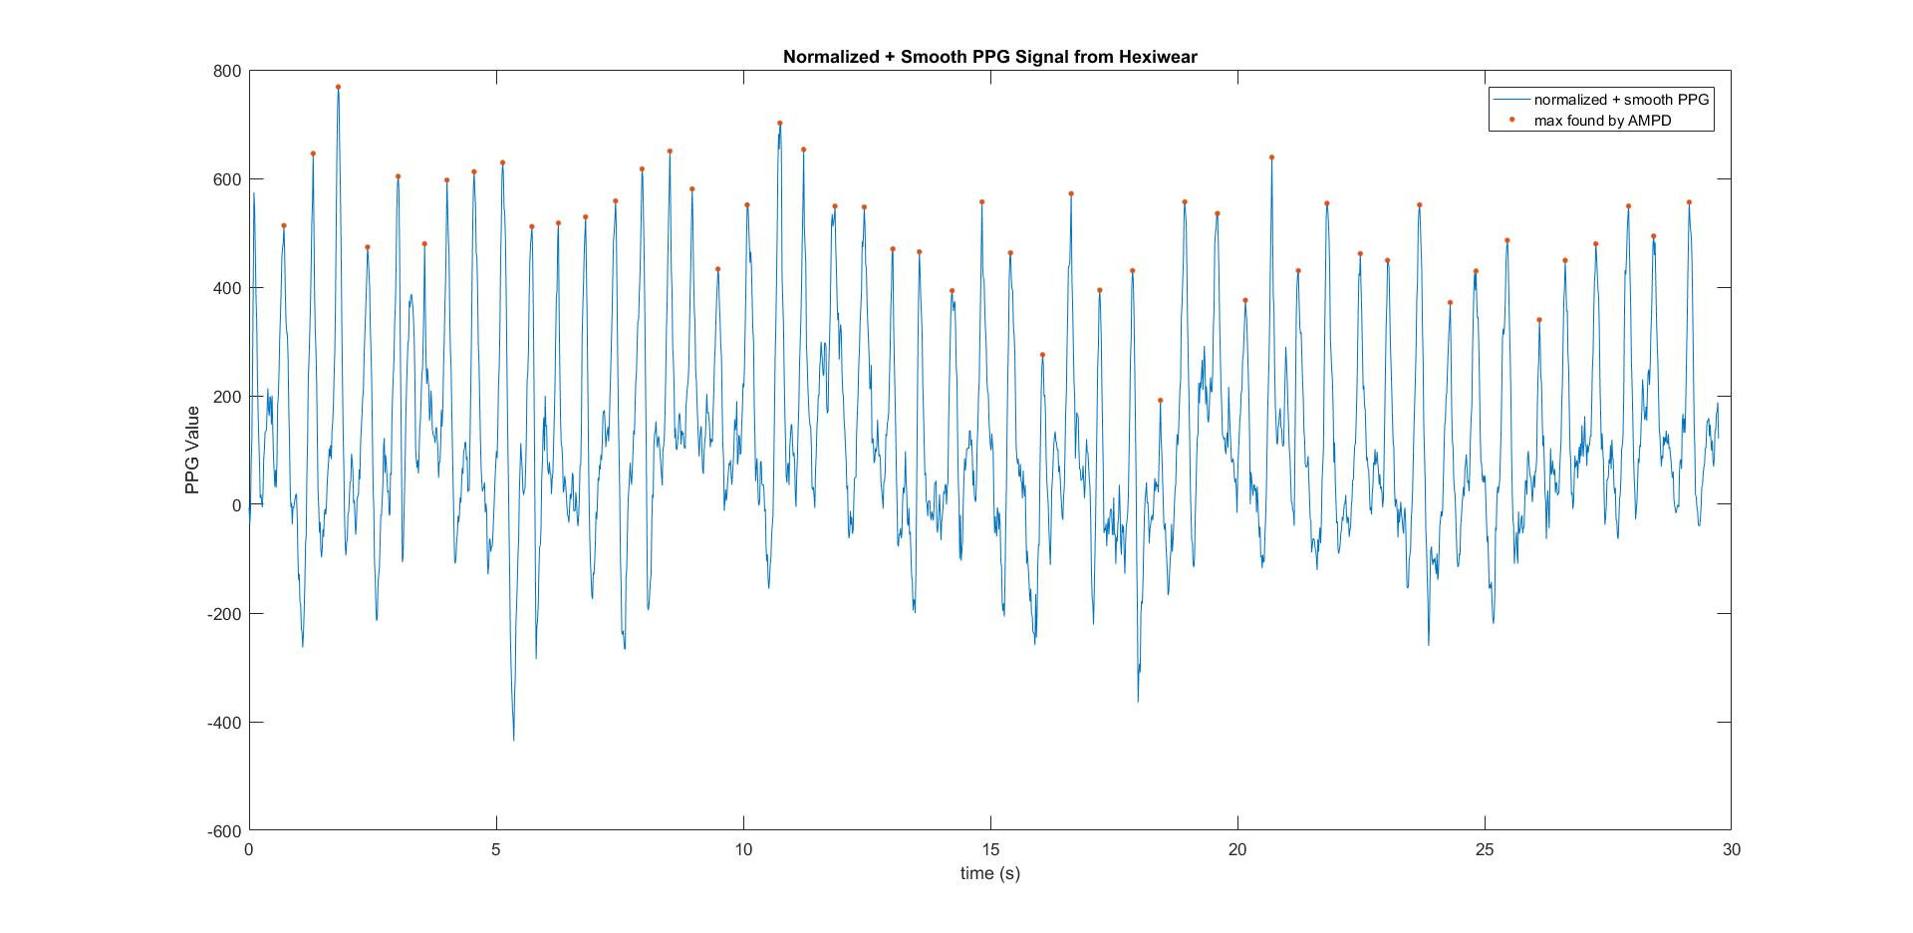

Slide 12
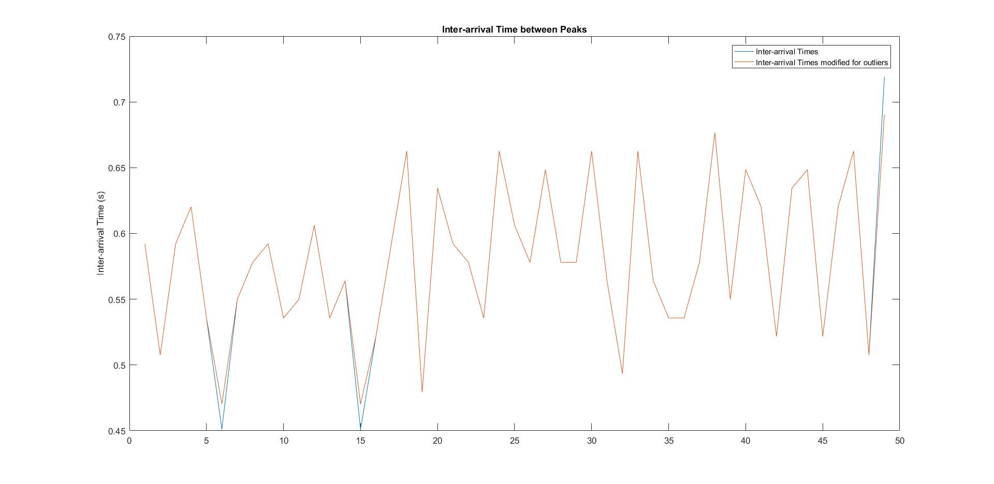

Slide 13
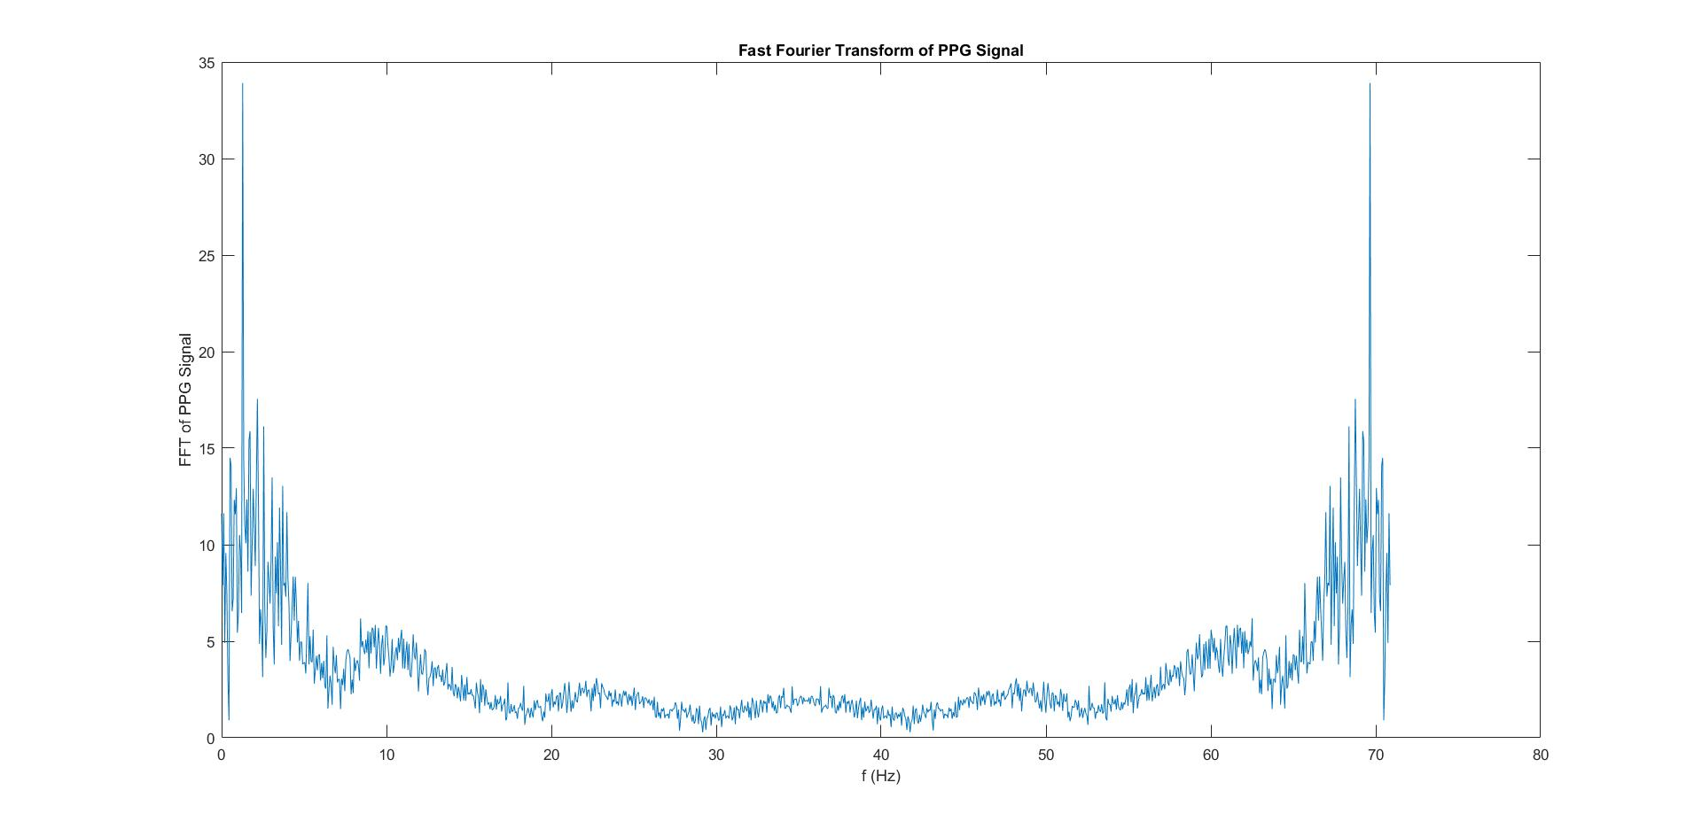

Slide 14
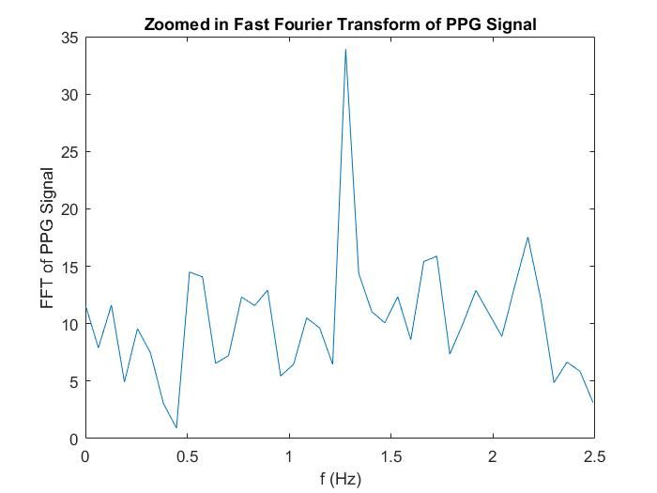
Notes:
Zoomed into range of interest

Slide 15
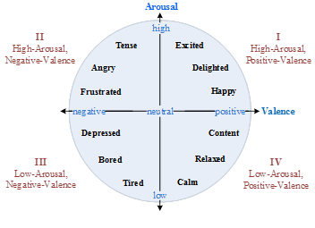
Mapping HRV to Mood
SDNN and LF/HF related to Valence/Arousal
SDNN can be used to estimate the valence axis.^{[2]}
LF/HF can be used to estimate the arousal axis.^{[2]}
Russel’s Valence/Arousal model, or Circumplex Model of Affect, can be used to describe mood.^{[3]}
Change of SDNN and gain of LF/HF can be used to estimate change of mood.^{[4]}
[2] Hui-Min Wang and Sheng-Chieh Huang. Musical Rhythms Affect Heart Rate Variability: Algorithm and Models. 2014.
[3] J. A. Russell, “A circumplex model of affect,” Journal of Personality and Social Psychology, vol. 39, no. 6, pp. 1161–1178, 1980.
[4] Kohzoh Yoshino and Katsunori Matsuoka. Correlation between mood and heart rate variability indices during daily life. 2011.

Slide 16
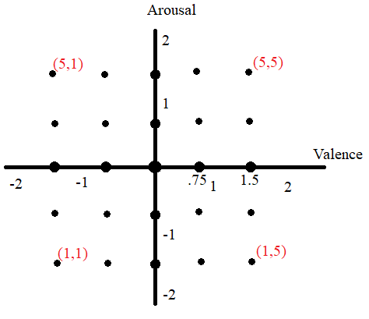
Taking the initial SDNN and initial LF/HF to map to the origin on the Valence/Arousal model, we mapped the next HRV measurements to one of 25 points on Valence/Arousal model.
If change of SDNN is in some range, we mapped it to one of 5 specified valence values selected from (-1.5, -0.75, 0, 0.75, 1.5)
Same for gain of LF/HF, respectively to arousal
Encoded (Arousal, Valence) to integer values between 1 and 5 for easier data transmission

Slide 17
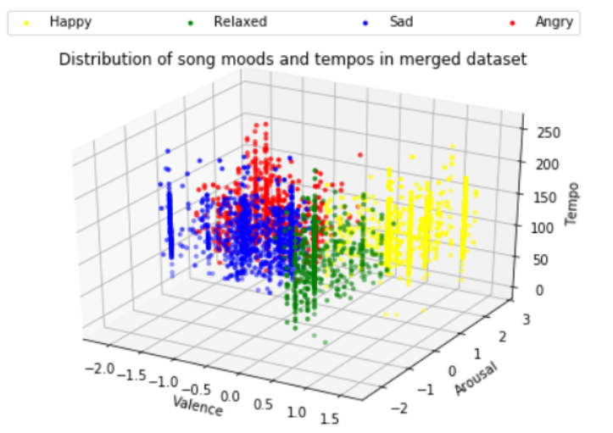
Mapping to Song Recommendation
Activity
Cadence -> Tempo
Mood
SDNN and HF/LF -> Valence and Arousal
Dataset to contextualize activity, mood
Deezer’s embedded song dataset
Crowdsourced tags, frequency analysis, Lyric semantic analysis
Cross referenced with Million Songs dataset To lift into 3rd dimension: tempo
Songs now have low-dimensional VAT Representation, ideal for KNN

Slide 18
Results

Slide 19
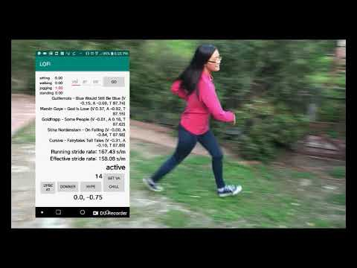
Demo

Slide 20
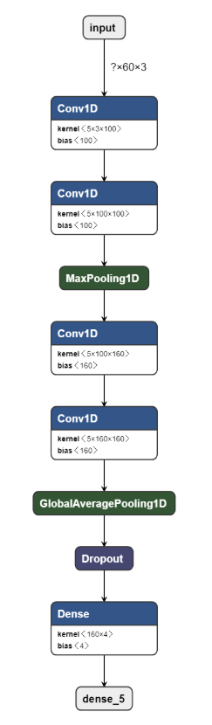
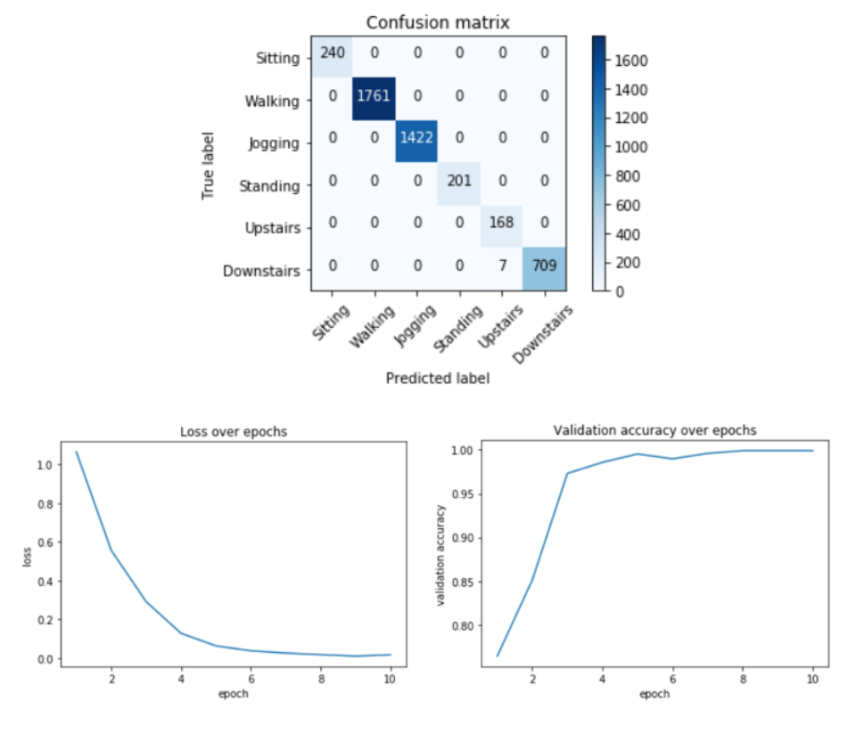
Activity Recognition and Cadence Accuracy

Slide 21
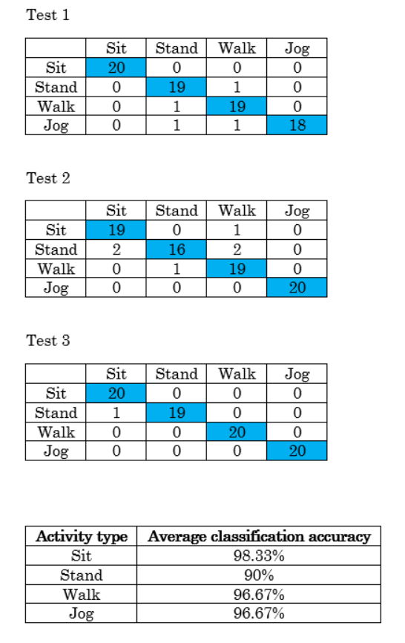
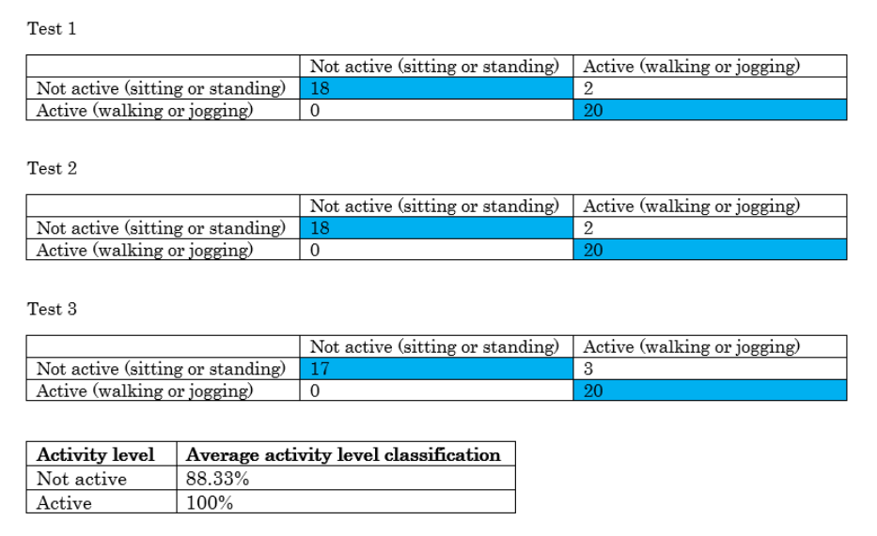
Activity Recognition and Cadence Accuracy

Slide 22
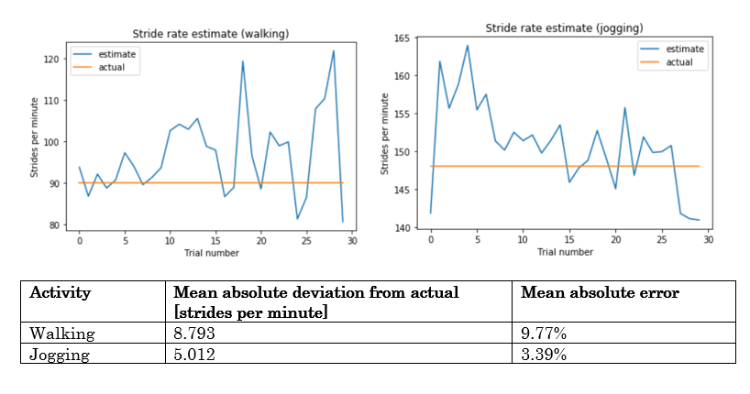
Activity Recognition and Cadence Accuracy

Slide 23
SDNN Accuracy
We tested to see if our calculated SDNN and HF/LF were reasonable by comparing to the measured SDNN and LF/HF from research paper [5].
[5] Fred Shaffer and J.P. Ginsbergy. “An Overview of Heart Rate Variability Metrics and Norms”. 2017.
[6] Ahmed Alqaraawi, Ahmad Alwosheel, and Amr Alasaad. “Heart rate variability estimation in photoplethysmography signals using Bayesian learning approach”. 2016.
 | Mean | Standard Deviation | Range
SDNN (ms) | 50 | 16 | 32 - 93
 | AMPD to find max | AMPD + Laplacian Probabilistic Approach^{[7]} | AMPD + Probabilistc + Bayesian Inference^{[7]} | AMPD to find min | Normalize and Smooth PPG + AMPD to find max
SDNN (ms) | 330 | 275 | 4737 | 260 | 54.9

Slide 24
HF/LF Accuracy
We tested to see if our calculated SDNN and HF/LF were reasonable by comparing to the measured SDNN and LF/HF from research paper [5].
We calculated HF/LF over a 30 second interval and got
HF_LF = 0.763
[5] Fred Shaffer and J.P. Ginsbergy. “An Overview of Heart Rate Variability Metrics and Norms”. 2017.
 | Mean | Standard Deviation | Range
LF/HF | 2.8 | 2.6 | 1.1 - 11.6
HF/LF (not in paper; derived from above) | 0.357 | N/A | 0.086 - 0.909

Slide 25
Mood Accuracy
Subject (not one of the creators) had HRV measured with no stimuli for 30 seconds and then while watching a sad video of animals almost dying.
Film clips are used in research to elicit certain emotional responses.^{[7]}
PPG signal was measured by placing the Hexiwear on the subject’s index finger. PPG data for subject when watching sad video was split into two 15 sec intervals.
Results:
[7] J. Rottenberg, R. D. Ray, and J. J. Gross, “Emotion elicitation using films.” 2007.
 | SDNN (ms) | HF/LF | (Valence, Arousal)
No Stimuli | 93.71 | 0.9796 | Ref (0, 0)
Sad video (0:15 sec) | 76.16 | 0.892 | (-0.75, 0)
Sad video (15:30 sec) | 75.49 | 0.691 | (-0.75, -0.75)

Slide 26
Reflection

Slide 27
Challenges
Hexiwear going into Maintenance Mode, difficulty communicating directly to Android via BLE, heart rate measurement inaccuracy & methodology, relative lack of Hexiwear documentation/community questions
Researching and deciding on how to represent emotions i.e. major design choices at outset of project
More involved Android programming (handling asynchronous tasks like opening file streams to sites)
Debugging entire system when all running at once, isolating problems

Slide 28
Future Improvements
More accurate way to measure heart data
Measure directly on index finger
Use a better measurement instrument
Measure ECG (electrocardiogram) instead of PPG
Measure more than 1 physiological signal (skin conductance?) non-invasively
More complex algorithm for signal processing for better results
Take into account user preferences (genre, past listening history, similar users)
Autonomically play recommended songs by integrating Spotify API

Slide 29
Thank you!
Professor Srivastava and Leon
Our peers
Online communities, forums
Papers
Thank you for listening!

